Slide 1


Geometric data structure From theory to application
By Bao Ngo and Jared Rost

Slide 2





Table of contents
Motivation
Preliminaries
Methodology
Experiments
Results

Slide 3




Table of contents
Motivation
Preliminaries
Methodology
Experiments
Results

Slide 4
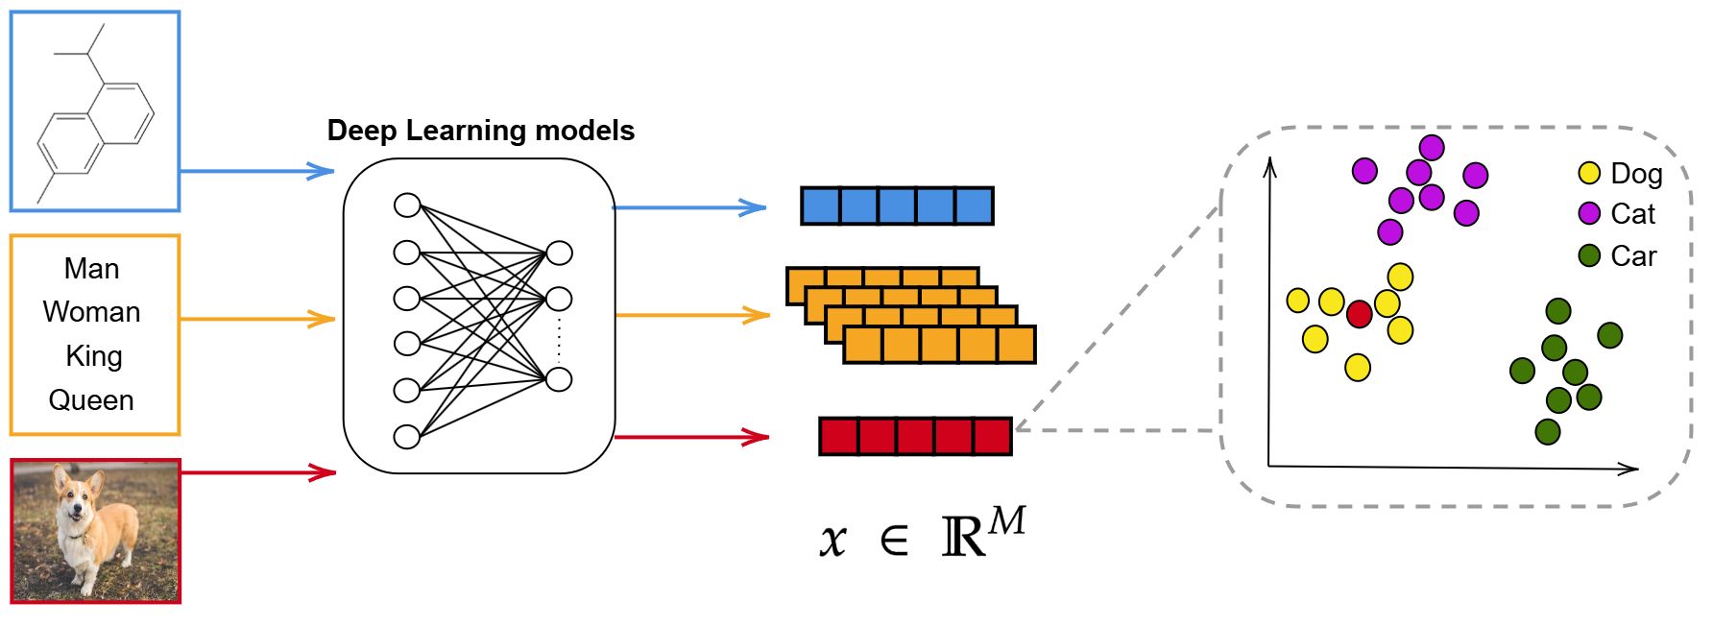

Motivation
Why geometric data structure?
We can use geometric data structure to find closest neighbors!!

Slide 5


Table of contents
Motivation
Preliminaries
Methodology
Experiments
Results

Slide 6

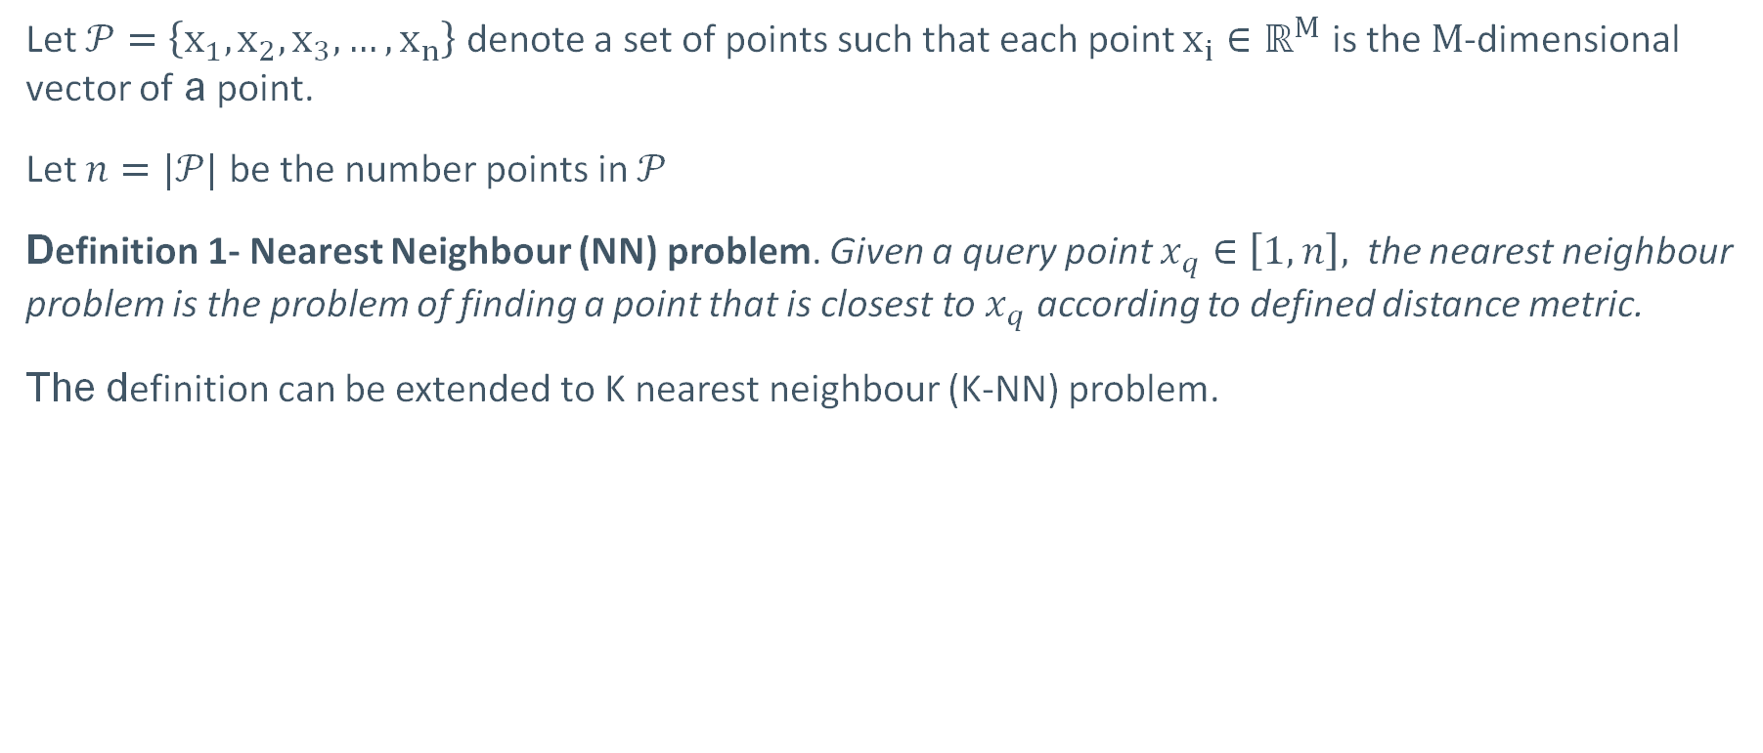
Preliminaries
Let $𝒫=\left\{x_{1},x_{2},x_{3},…, x_{n}\right\}$ denote a set of points such that each point $x_{i}∈ℝ^{M}$ is the $M$-dimensional vector of a point.
Let $n=|𝒫|$ be the number points in $𝒫$
Definition 1- Nearest Neighbour (NN) problem. Given a query point $x_{q}∈\left[1,n\right],$ the nearest neighbour problem is the problem of finding a point that is closest to $x_{q}$ according to defined distance metric.
The definition can be extended to K nearest neighbour (K-NN) problem.

Slide 7
Table of contents
Motivation
Preliminaries
Methodology
Experiments
Results

Slide 8

Methodology
This work focuses on evaluating the performance of geometrics data structures from practical perspectives
Evaluated methods : K-D Tree [1] and Ball* Tree [2]
Focused operations: insert, delete, tree construction, get NN and get KNN
Trees are evaluated on large scale real-world datasets [3] with various properties
Number of nodes : 50,000 – 2,000,00
Dimension of each data point : 128 - 4,096

Slide 9
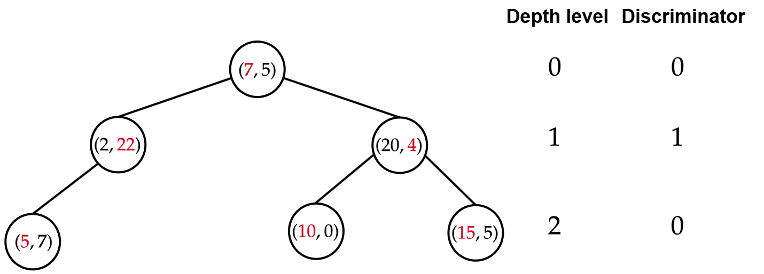
Methodology
K-D Tree
K-D tree is a binary search tree and each node represents a K-dimensional point
Childs nodes are split into left or right subtree according to the value at a dimension defined by discriminator

Slide 10
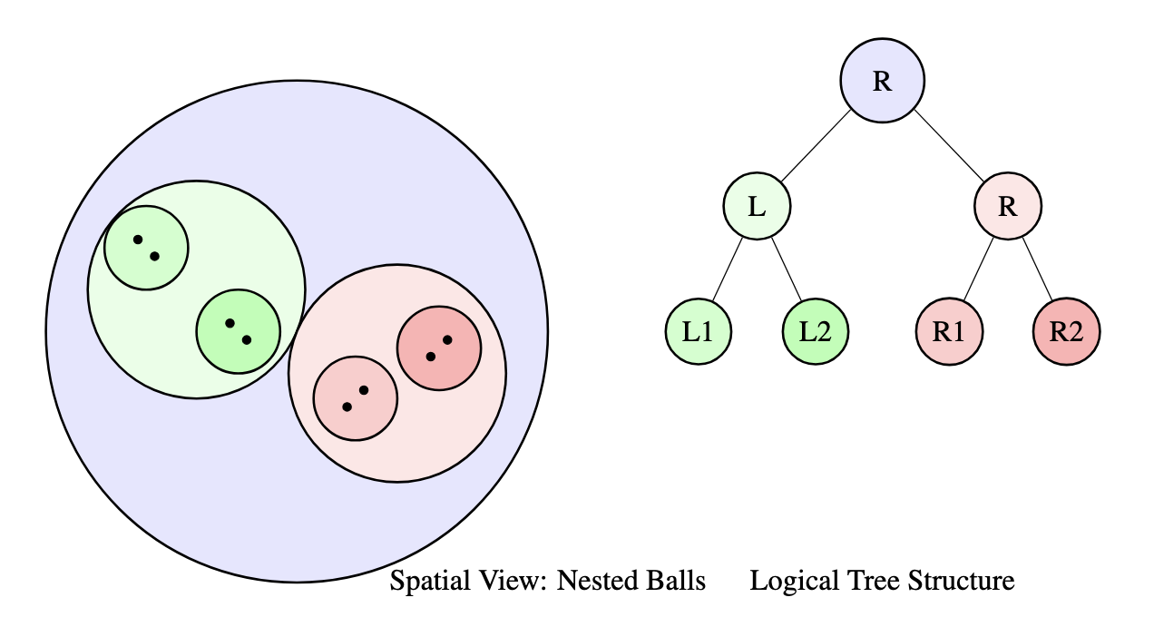
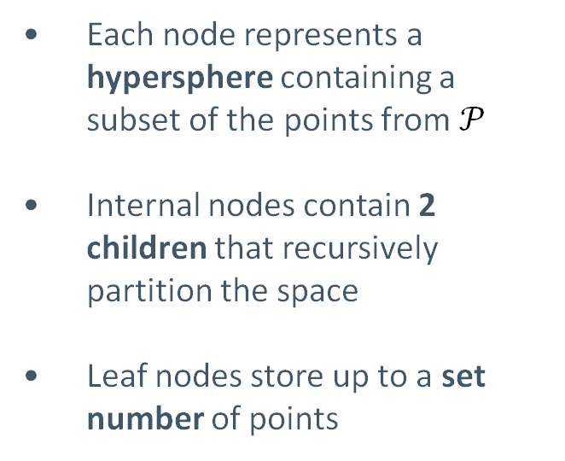
Methodology
Ball* Tree
Each node represents a hypersphere containing a subset of the points from $𝒫$
Internal nodes contain 2 children that recursively partition the space
Leaf nodes store up to a set number of points

Slide 11
Methodology
Ball* Tree
Ball* Tree improves on the Ball Tree by using Principal Component Analysis based splits instead of median
During construction it detects and handles poor splits by forcing a leaf
Designed to work with higher dimensionality and scale data

Slide 12
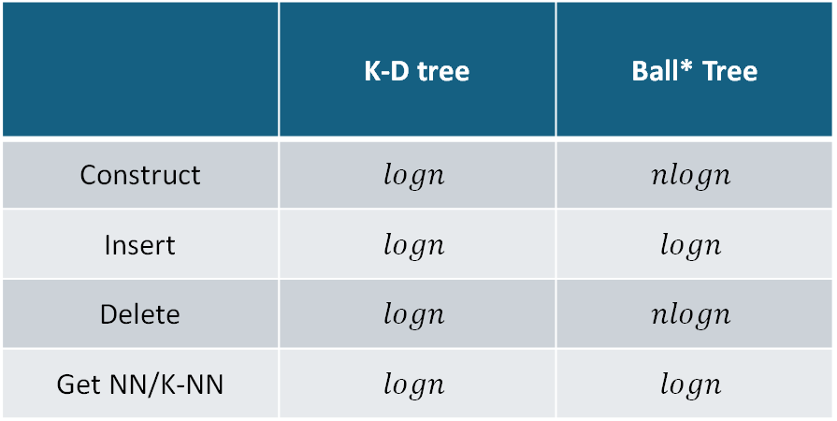
Methodology
Time complexity of all operations
 | K-D tree | Ball* Tree
Construct | $$logn$$ | $$nlogn$$
Insert | $$logn$$ | $$logn$$
Delete | $$logn$$ | $$nlogn$$
Get NN/K-NN | $$logn$$ | $$logn$$

Slide 13
Table of contents
Motivation
Preliminaries
Methodology
Experiments
Results

Slide 14
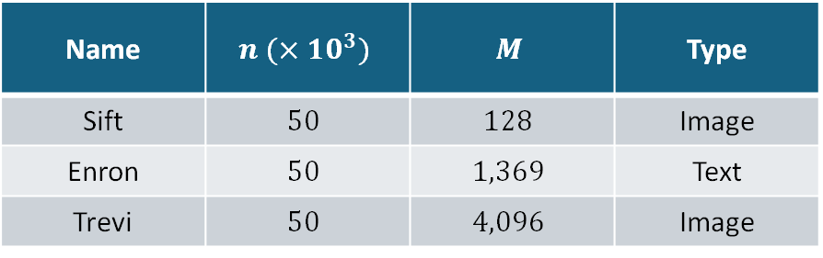
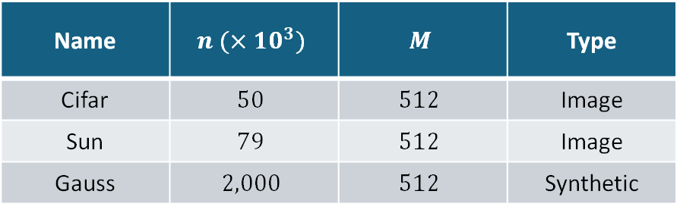
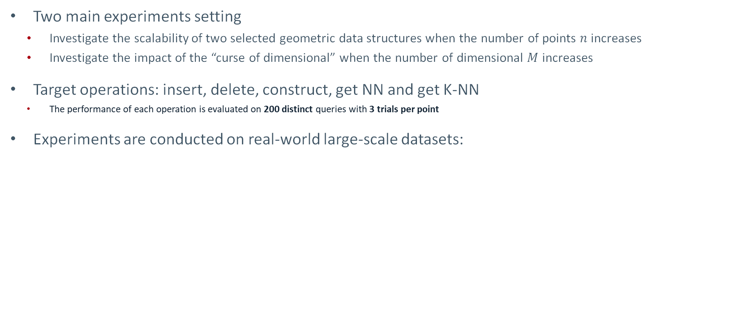
Experiments
Two main experiments setting
Investigate the scalability of two selected geometric data structures when the number of points $n$ increases
Investigate the impact of the “curse of dimensional” when the number of dimensional $M$ increases
Target operations: insert, delete, construct, get NN and get K-NN
The performance of each operation is evaluated on 200 distinct queries with 3 trials per point
Experiments are conducted on real-world large-scale datasets:
Scalability Datasets
Dimensionality Datasets
Name | $$n (×10^{3})$$ | $$M$$ | Type
Cifar | $$50$$ | $$512$$ | Image
Sun | $$79$$ | $$512$$ | Image
Gauss | $$2,000$$ | $$512$$ | Synthetic
Name | $$n (×10^{3})$$ | $$M$$ | Type
Sift | $$50$$ | $$128$$ | Image
Enron | $$50$$ | $$1,369$$ | Text
Trevi | $$50$$ | $$4,096$$ | Image

Slide 15
Table of contents
Motivation
Preliminaries
Methodology
Experiments
Results

Slide 16
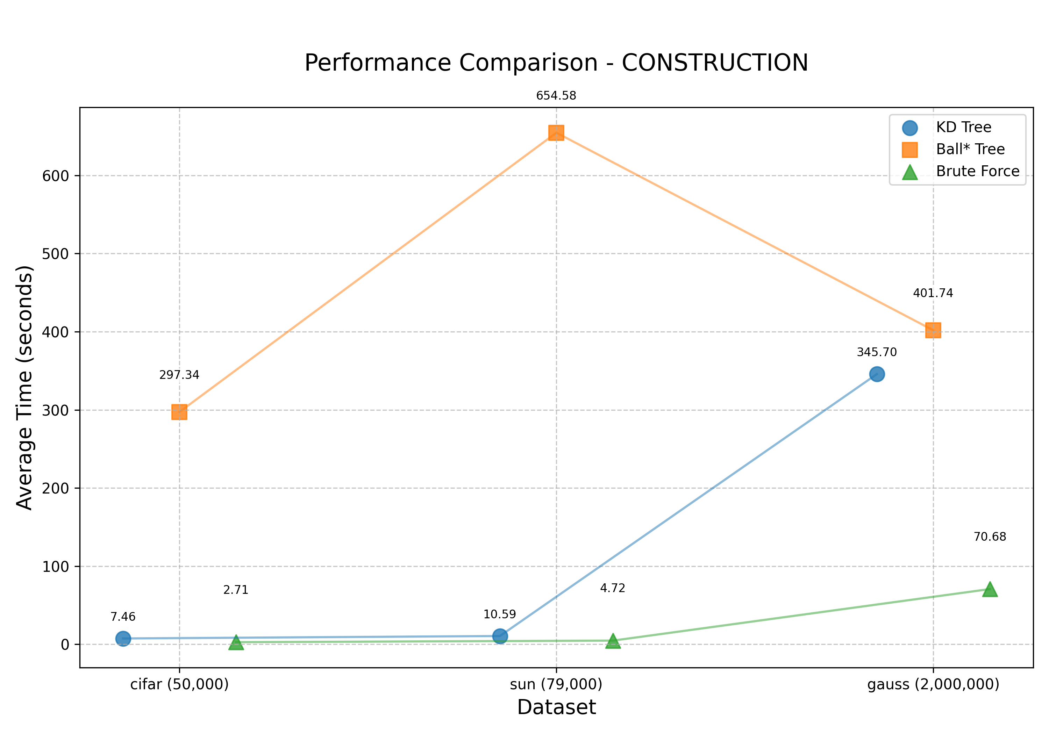
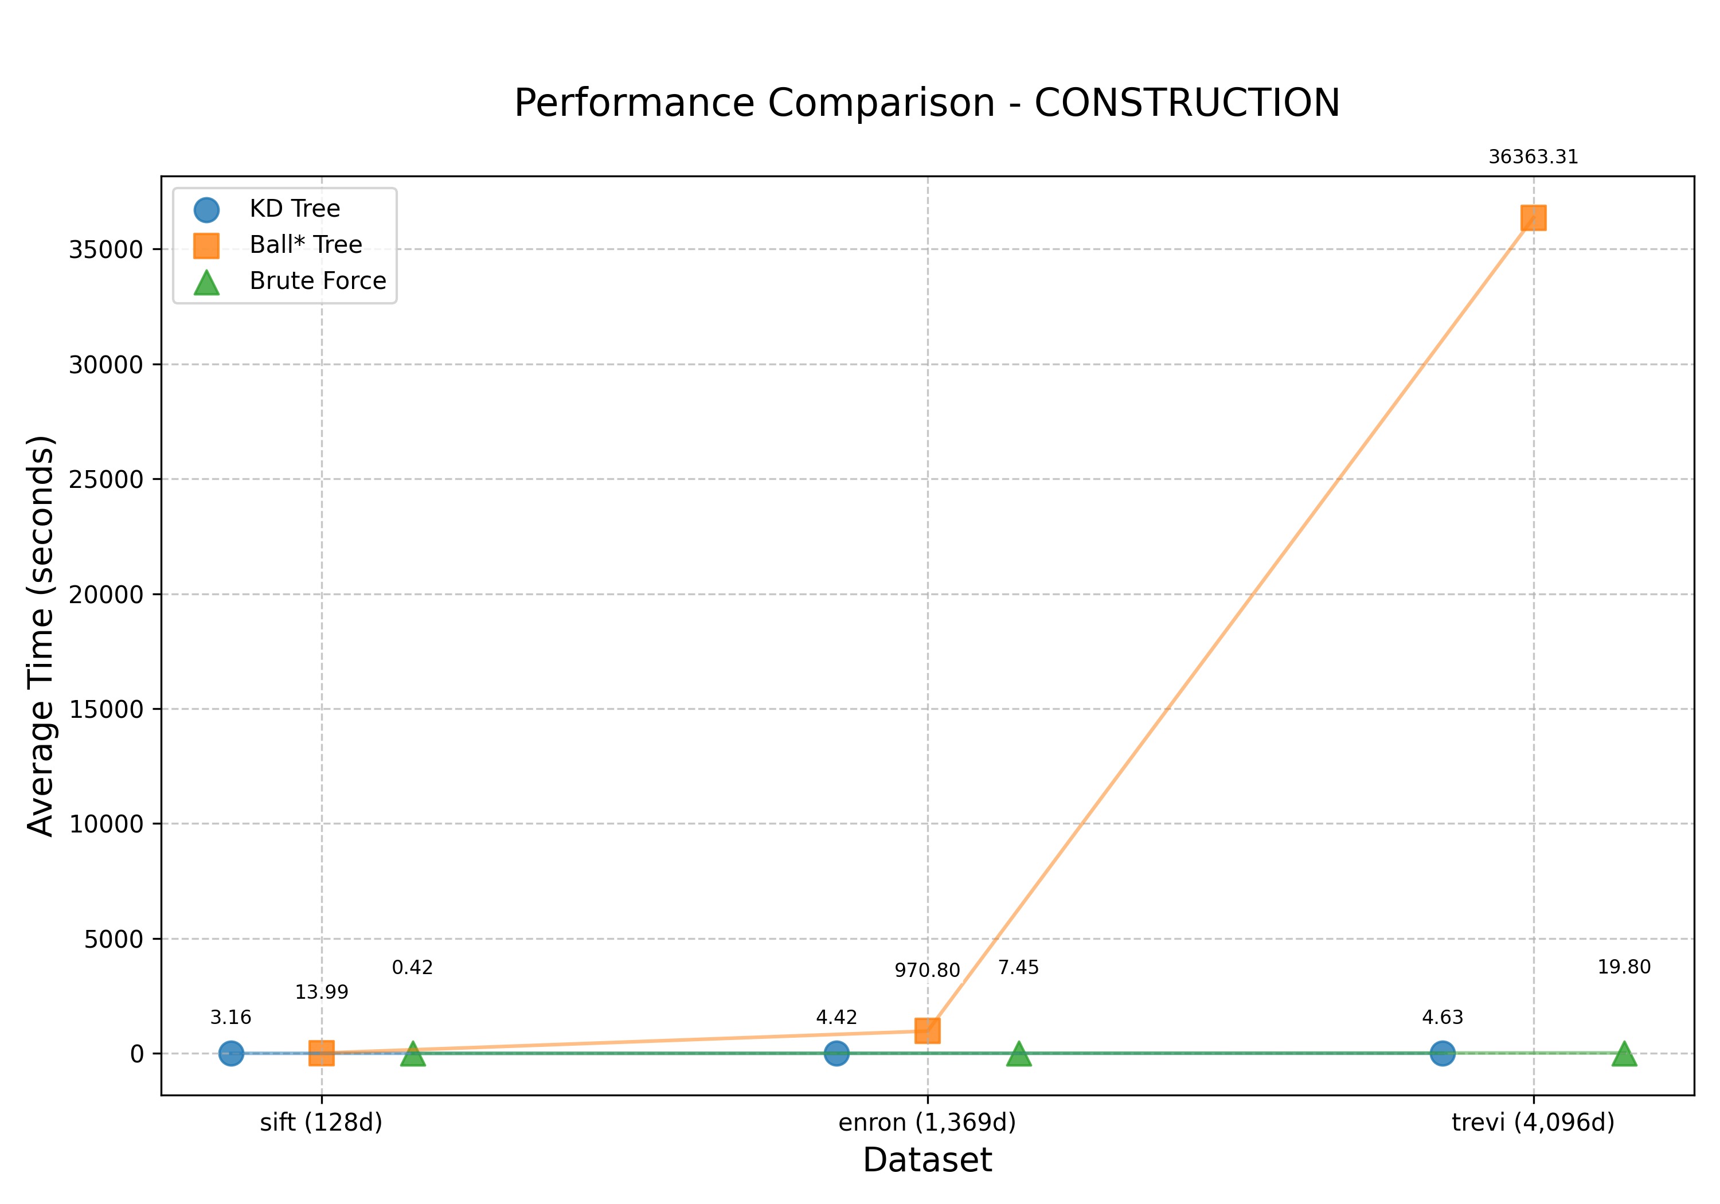
Results
Scalability Results
Dimensionality Results

Slide 17
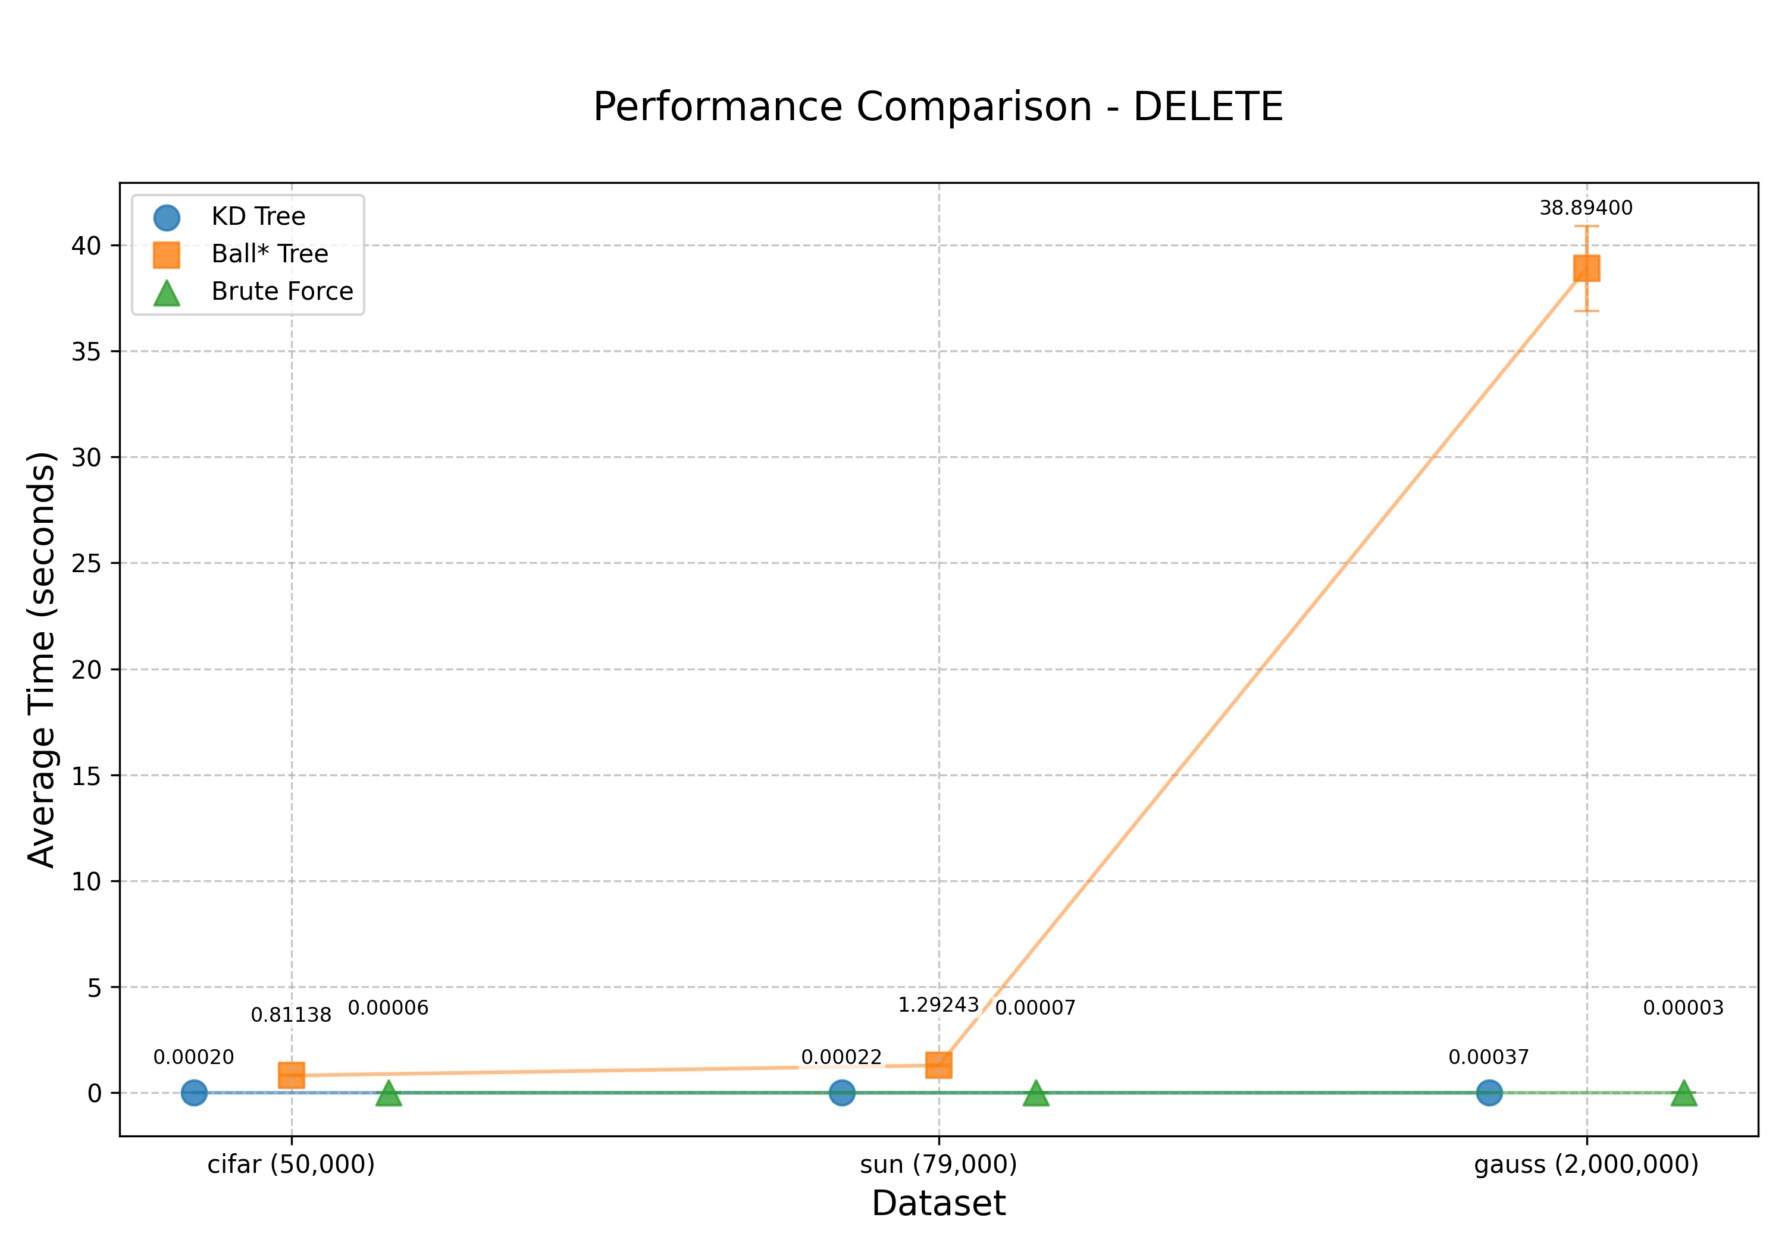
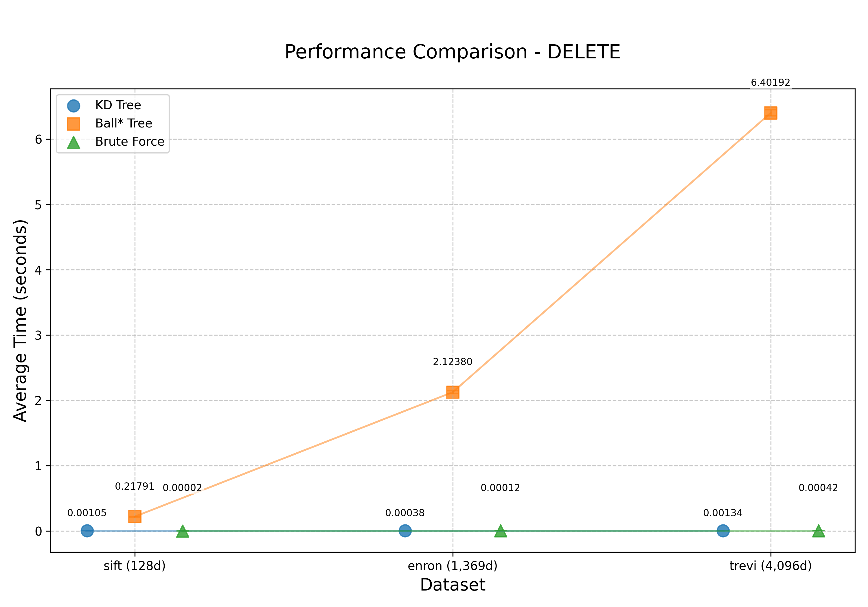
Results
Scalability Results
Dimensionality Results

Slide 18
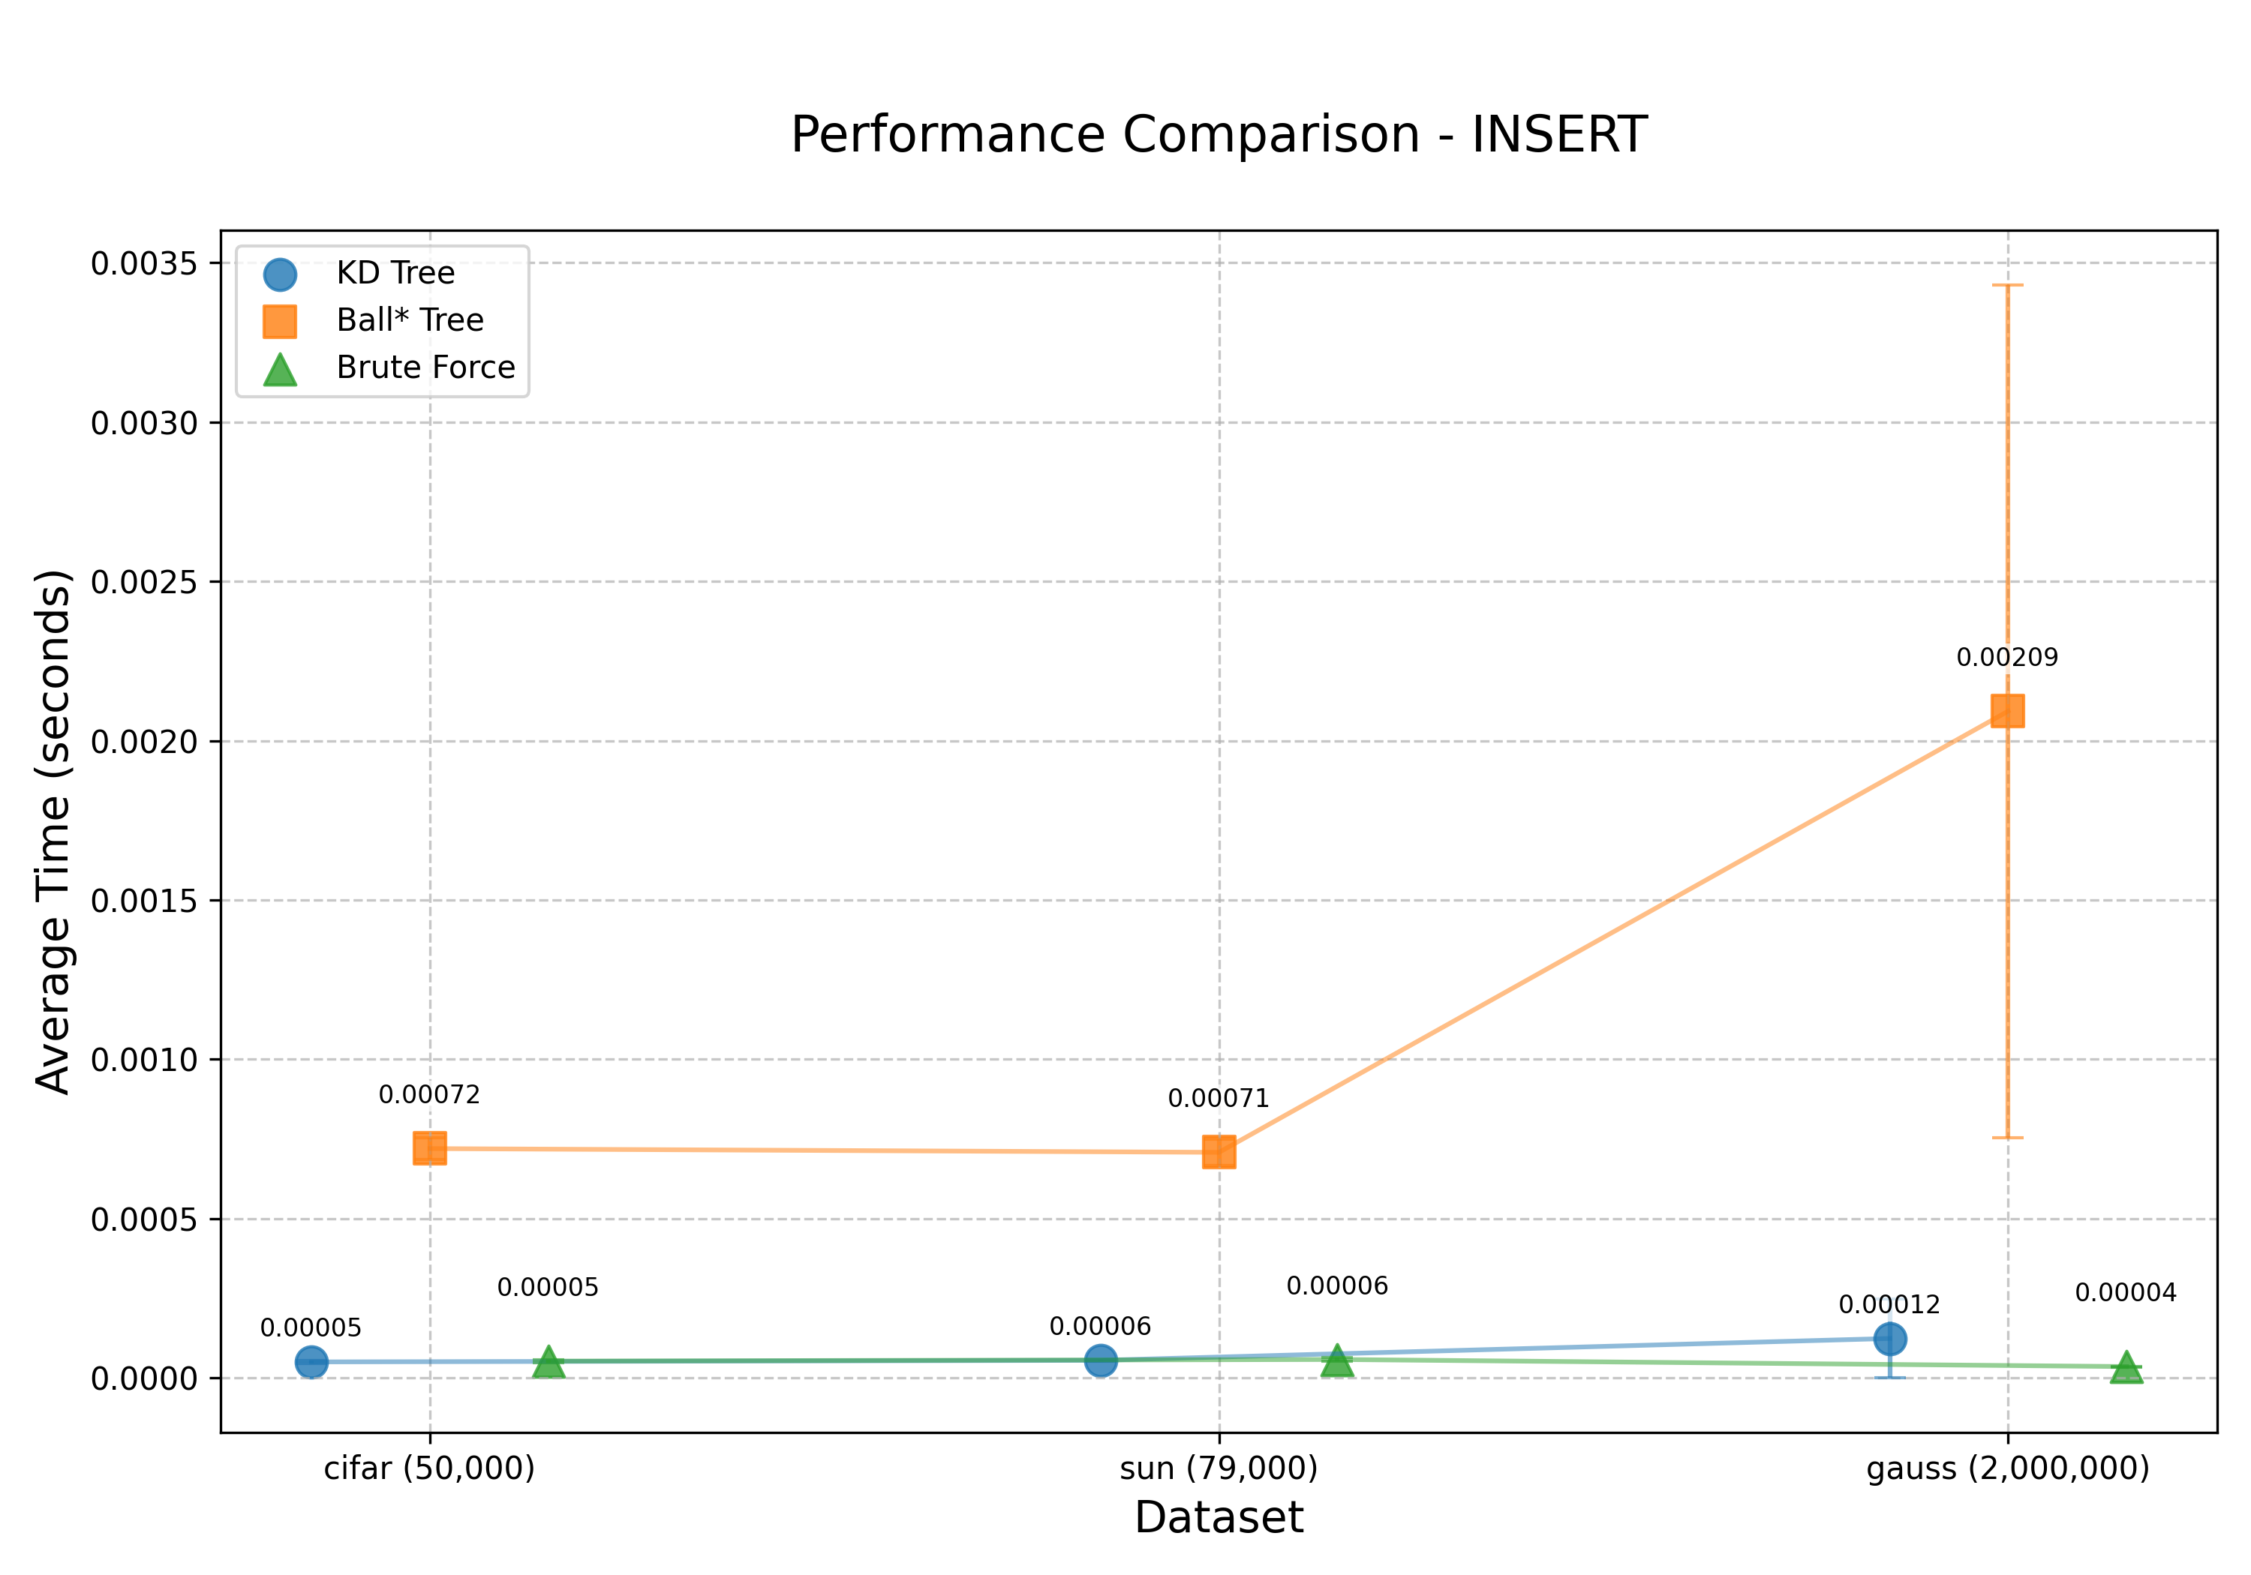
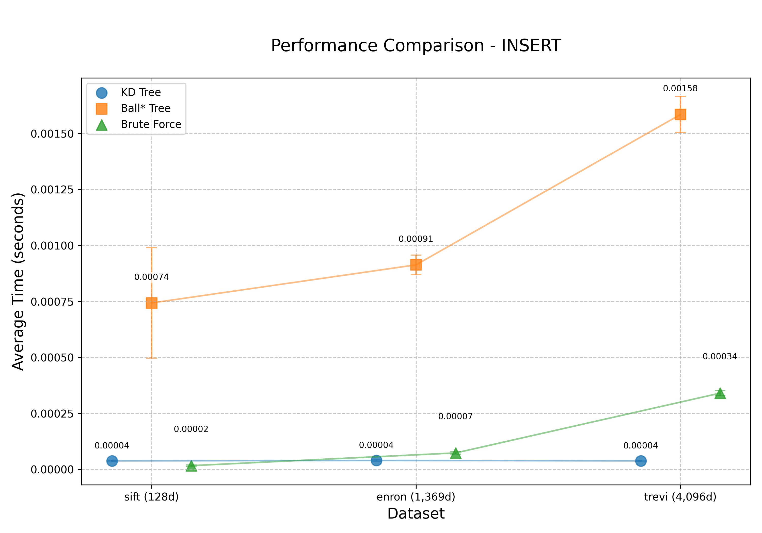
Results
Scalability Results
Dimensionality Results

Slide 19
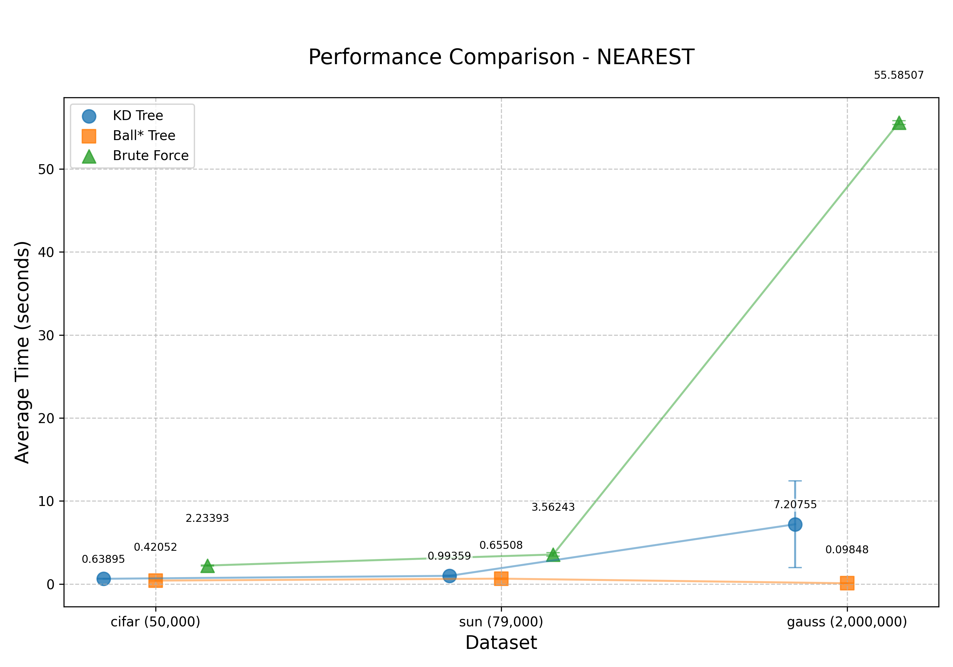
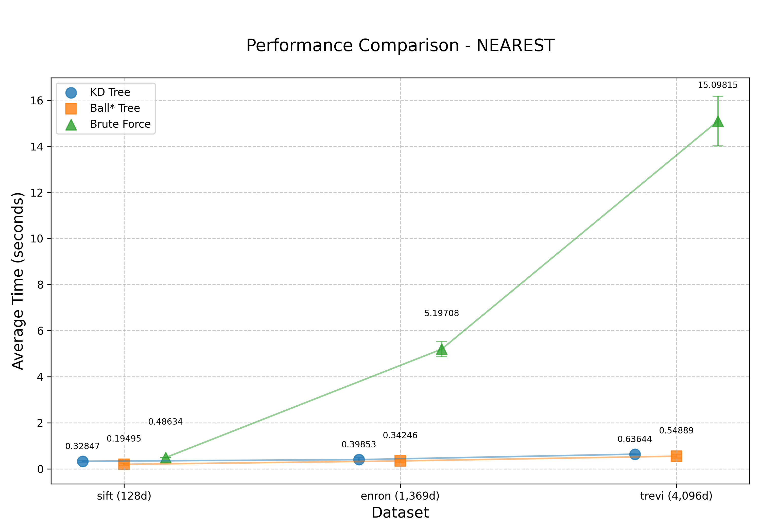
Results
Scalability Results
Dimensionality Results

Slide 20
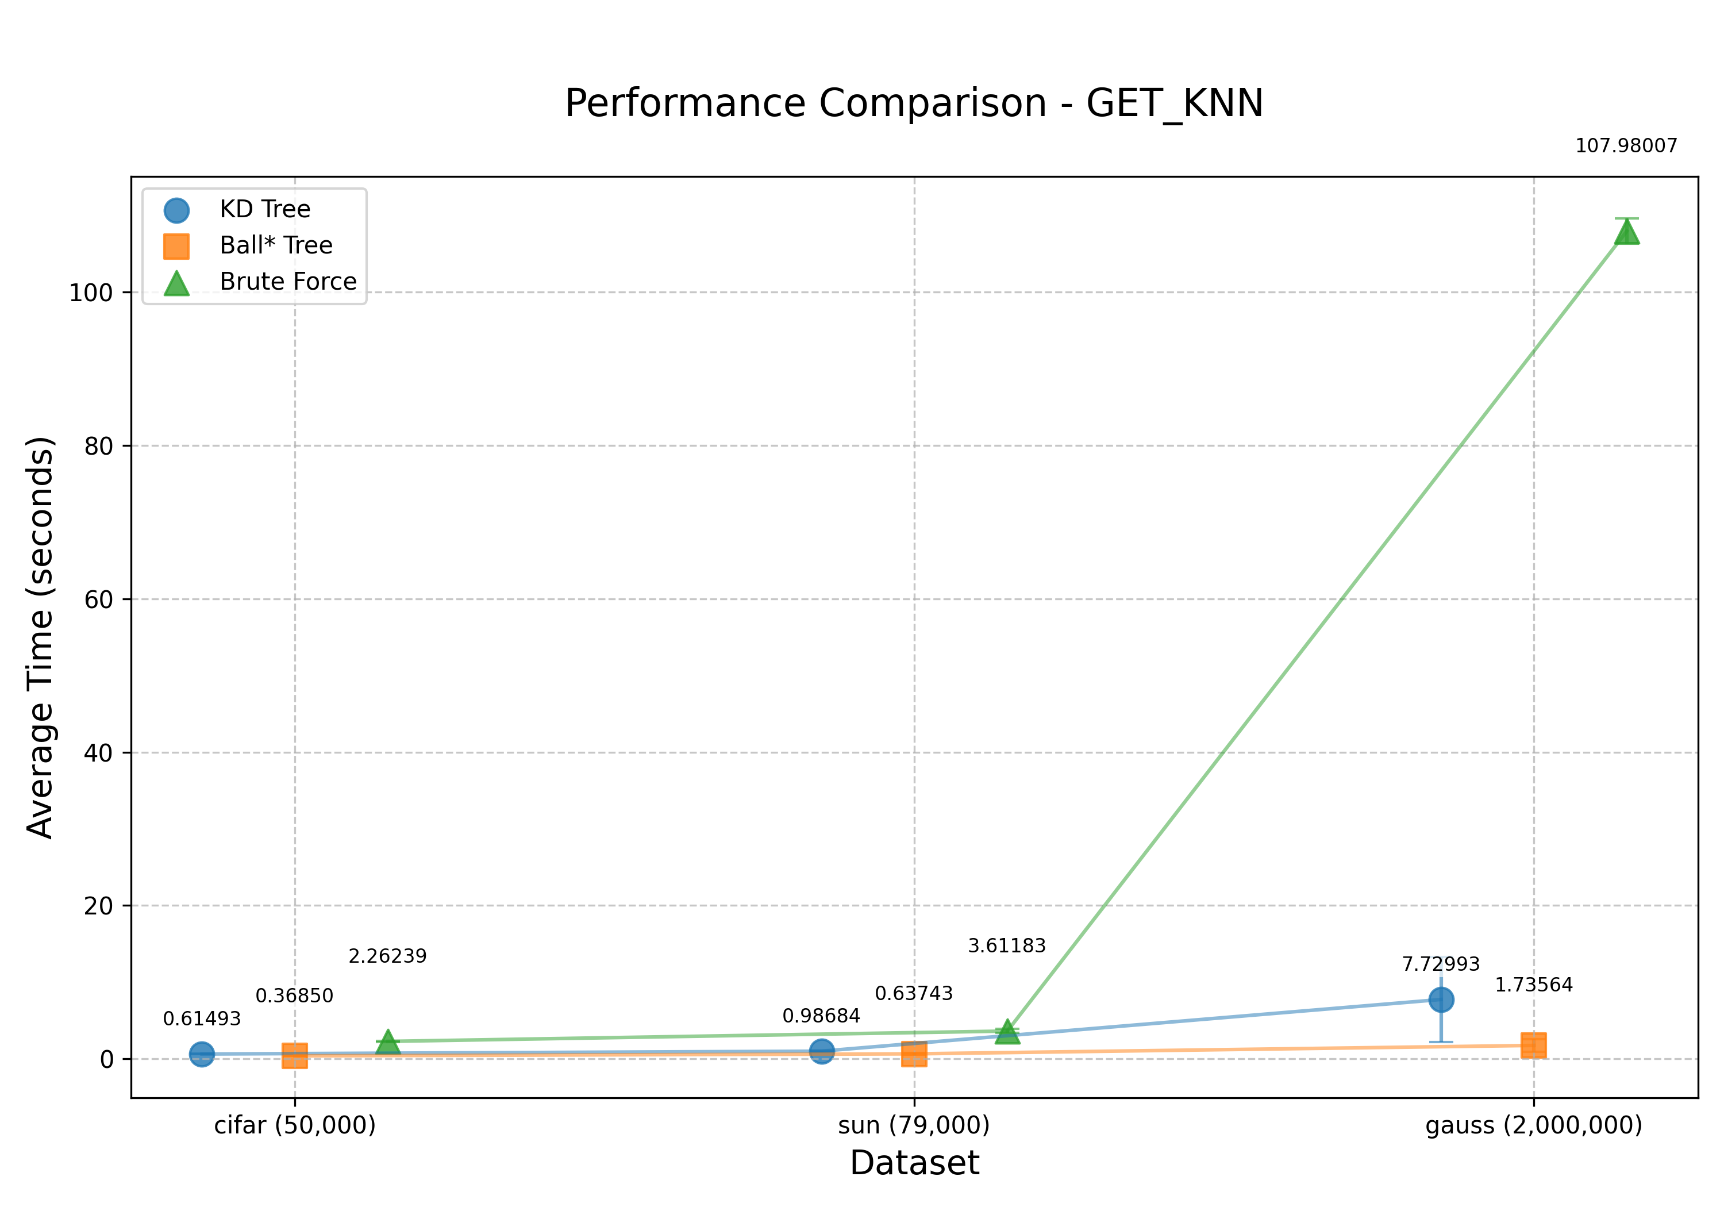
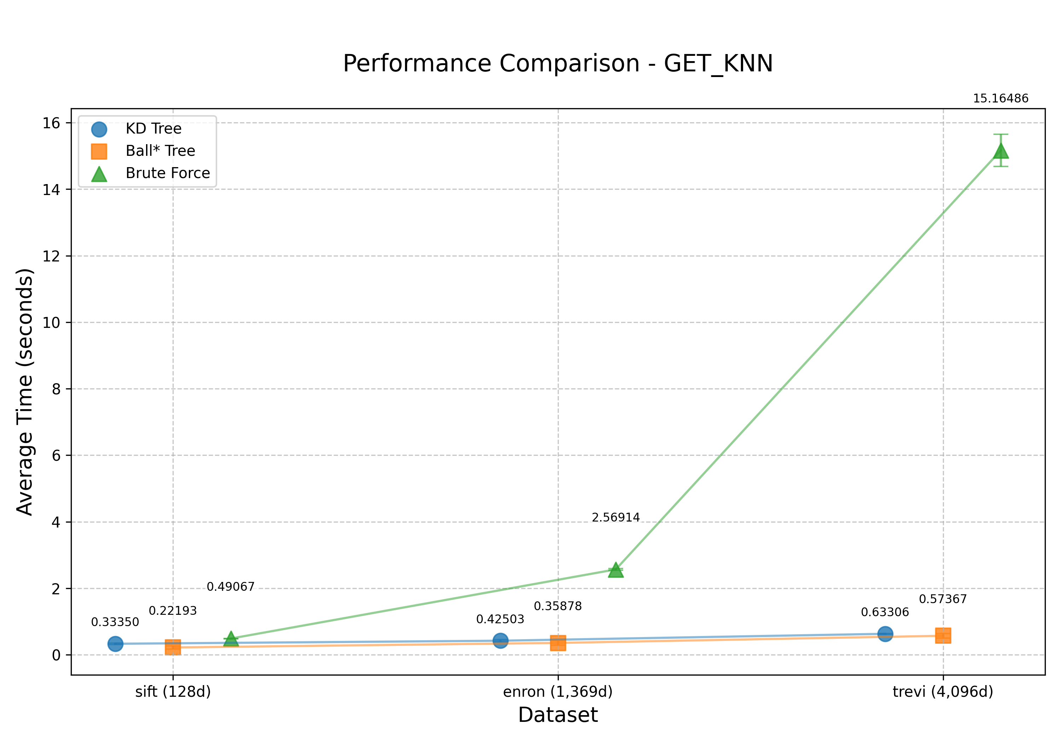
Results
Scalability Results
Dimensionality Results

Slide 21
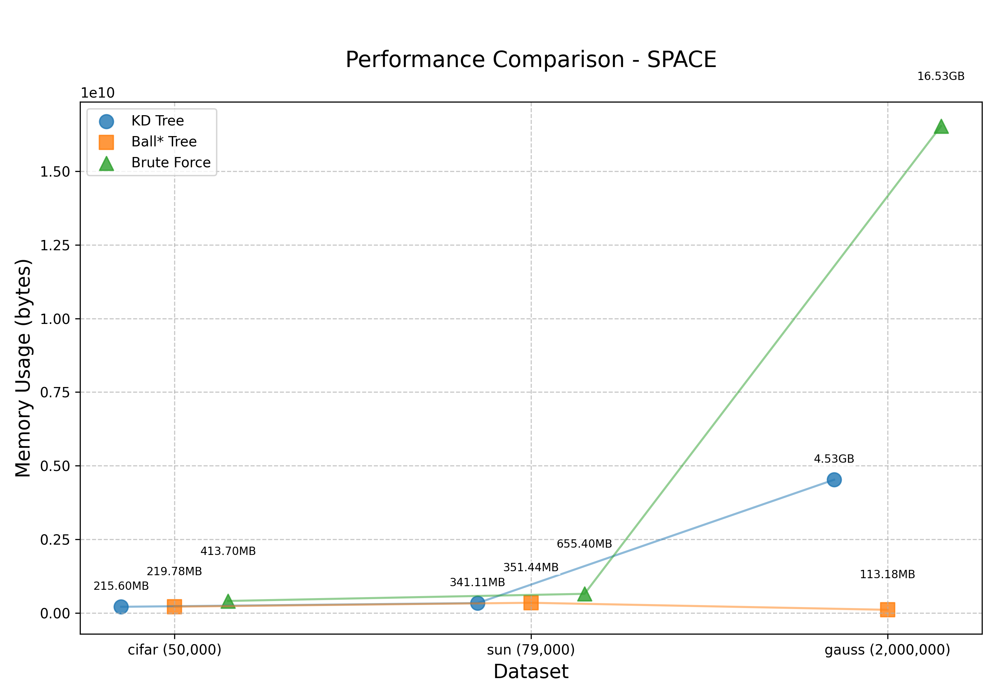
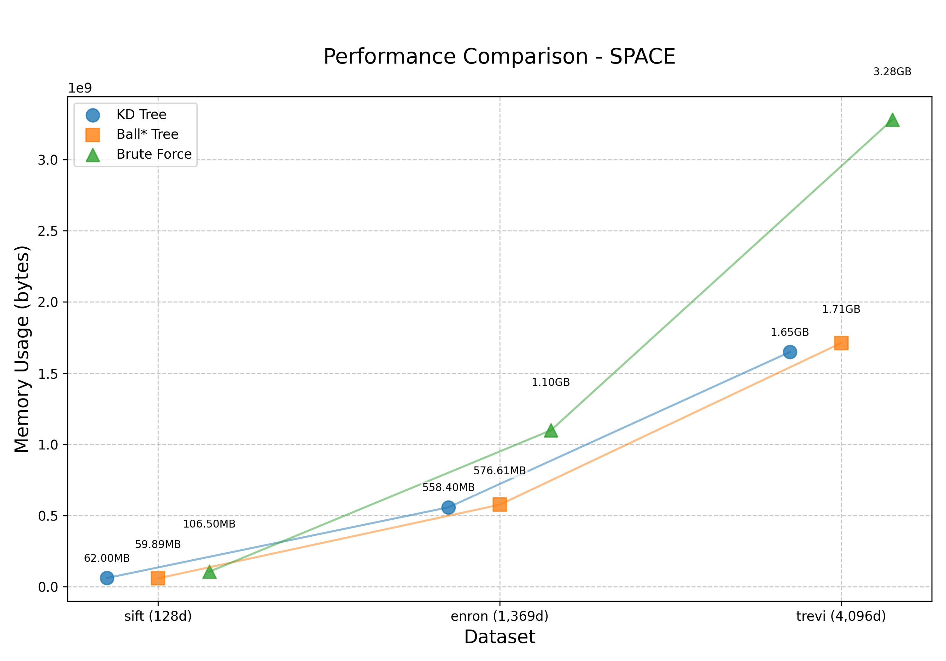
Results
Scalability Results
Dimensionality Results

Slide 22
Results
Ball* Tree
Significantly worse performance on insert, delete, and construction
Moderately better performance on Nearest and KNN operations on all datasets
Works best with datasets that follow normal distribution
KD Tree
Consistent performance across all operations
KNN performance begins to degrade with larger datasets
Surprisingly good at higher dimensionality datasets
Seems to be unaffected by underlying distribution of dataset

Slide 23
References
[1] Bentley, Jon Louis. "Multidimensional binary search trees used for associative searching." Communications of the ACM 18.9 (1975): 509-517.
[2] Dolatshah, Mohamad, Ali Hadian, and Behrouz Minaei-Bidgoli. "Ball*-tree: Efficient spatial indexing for constrained nearest-neighbor search in metric spaces." arXiv preprint arXiv:1511.00628 (2015).
[3] Li, Wen, et al. "NNS Benchmark: Evaluating Approximate Nearest Neighbor Search Algorithms in High Dimensional Euclidean Space." 2024,

Slide 24

Thanks for listening!
Acknowledgement to Jennifer Vaughan for her guidance on project

